Slide 1
Brand Detector
Team BASA​

Slide 2
contents
Introduction​
Primary goals
​Inside the project
Solutions
​Summary​

Slide 3
Introduction
We team BASA worked on creating an AI-based software to detect brands for their logos and writings in a video thus providing a wide range of applications for social media monitoring and e-com sectors.

Slide 4
PRIMARY GOALS
What does it do ?

Slide 5
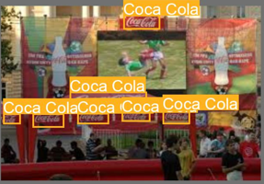


Detect brands from their logos

Slide 6
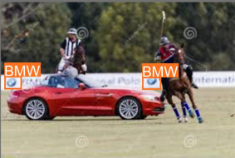
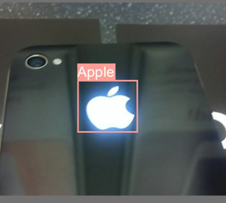
Some more results

Slide 7





Inside the project
YOLO
Darknet
Training
Accuracy
upgradation
An image detecting software for animals and vehicles
The neural network acts as a backbone for YOLO
Data set of 50 images with epochs = 3
Works with an accuracy of 35%
Can increase further accuracy with more data sets and usage

Slide 8
BUSINESS OPPORTUNITIES ARE LIKE BUSES. THERE'S ALWAYS ANOTHER ONE COMING.
“
”
Richard Branson

Slide 9
Solutions
Social media monitoring
Tracking sentiments
Can identify trends in change of customer behavior
Can determine whether the public has what type of opinion to a product and make changes to the product accordingly
Analyzing trends from social media posts and images about a particular product
It can also be used to analyze the emergence of a new brand
Measuring brand awareness
Monitoring customer service
We can help businesses measure their brand awareness and identify opportunities to increase visibility.
It can also be used to detect any fake products or duplicates in the market
Social media monitoring can also help businesses to identify customer service issues
It can also help to respond to customer complaints or inquiries

Slide 10
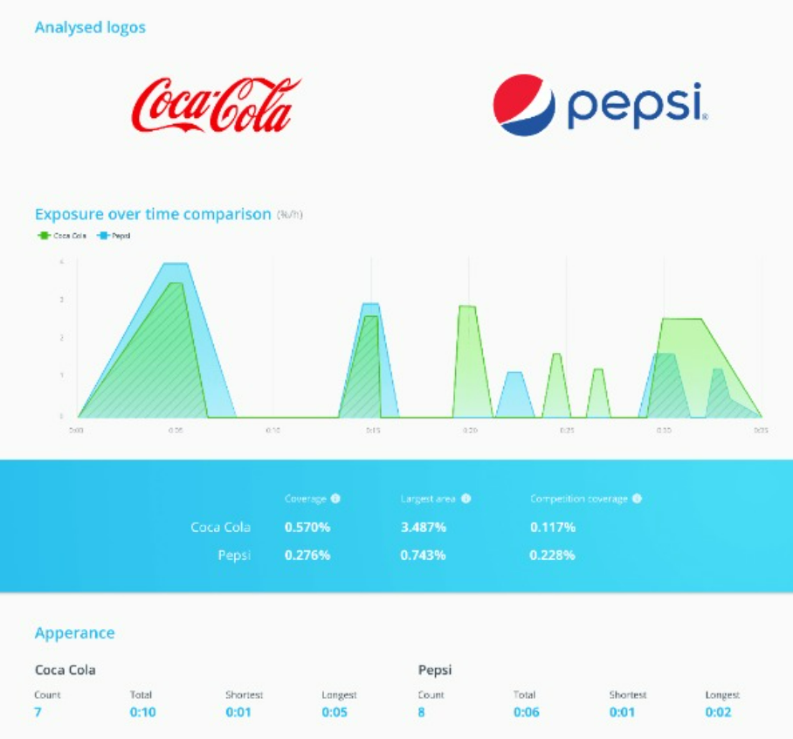
Case study
COCA-COLA VS PEPSI

Slide 11
SUMMARY
Our team aims to “make the world a better place to live in” and we firmly believe that our logo-detecting AI can play a significant role in that process. With some more time and data sets we will be able to perfect the model to detect any logos given to it.

Slide 12
THANK YOU
Team
Binshadh
Afra
Sita
Albert

